Slide 1












Slide 2


Slide 3

Multi-server agent jobs administration
with happy faces and pigeons
Mikey Bronowski

Slide 4
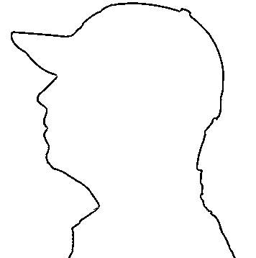



Mikey Bronowski
SQL DBA
Data Community member
Husband and father
AI Tech North ambassador

Slide 5

Agenda
WHAT ?
WHY ?
HOW ?

Slide 6
What? - CMS
CMS – Central Managment Server
Server Groups

Slide 7
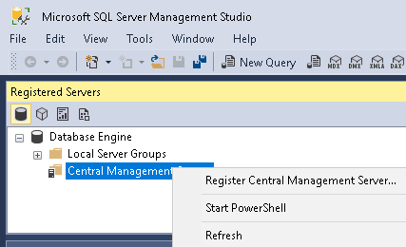
What? - CMS

Slide 8
What? - CMS - DEMO

Slide 9



What? - CMS
msdb
AD Auth only ServerGroupAdministratorRole
ServerGroupReaderRole

Slide 10
What? - MSX
MSX – Master server
TSX – Target server
Hidden feature of SQL Server

Slide 11






What? - MSX
Definition
One2Many
3…2…1

Slide 12
What? - MSX
Don’t be a pigeon

Slide 13
Why?
Challenges
Needs

Slide 14
How? - DEMO

Slide 15
Summary
CMS / Registered Servers
GUI / T-SQL / dbatools
Emoji in SQL
Master / Target Servers

Slide 16
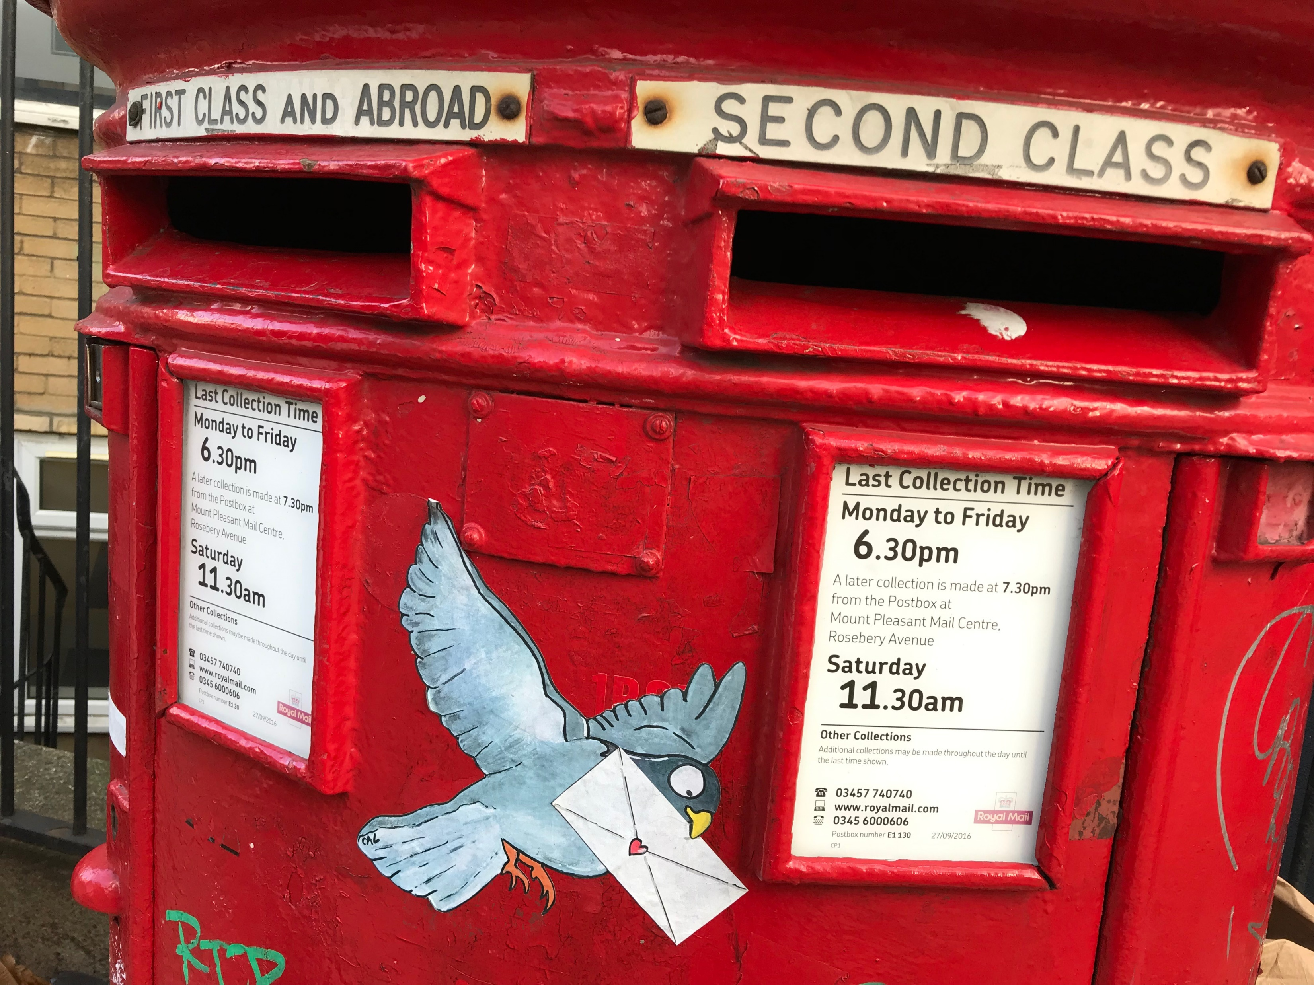
Don’t be a pigeon… really
www.flickr.com/photos/londonmatt/45275167535

Slide 17
Thank you

Slide 18
Mikey Bronowski
Linkedin.com / MikeyBronowski
MikeyBronowski @gmail.com
Github.com / MikeyBronowski
Twitter.com / MikeyBronowski

